Slide 1



OGC standards for geoscience
Speed dating with the standards
Sylvain Grellet

Slide 2
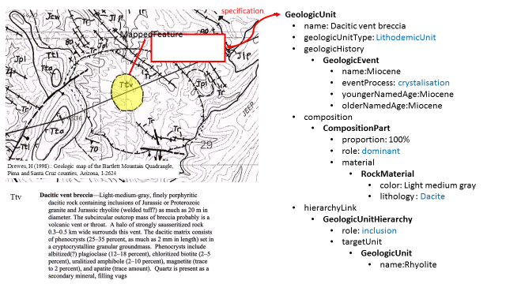

Name : GeoSciml
Logical model of geological features commonly
described and portrayed in geological maps,
cross sections, geological reports and databases.
Age : V 4.1
Key features
Covers the domain of geology (earth materials, geological units and stratigraphy, geological time, geological structures, geomorphology, geochemistry) and sampling features common to the practice of geoscience, such as boreholes and geological specimens.
Weight
Full and ‘Lite’ versions
Children / Family
Reused by many geological surveys and countries, continent wide spatial data/research infrastructures (INSPIRE, EPOS, AuScope, …)
Wishes
Currently moving to the semantic web
BRGM THE FRENCH GEOLOGICAL SURVEY WWW.BRGM.EU

Slide 3
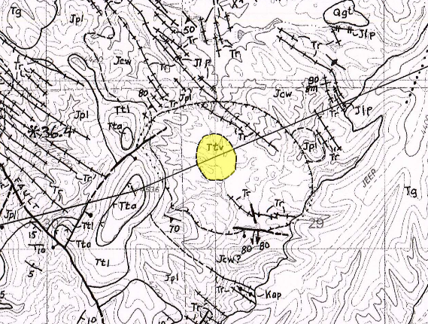
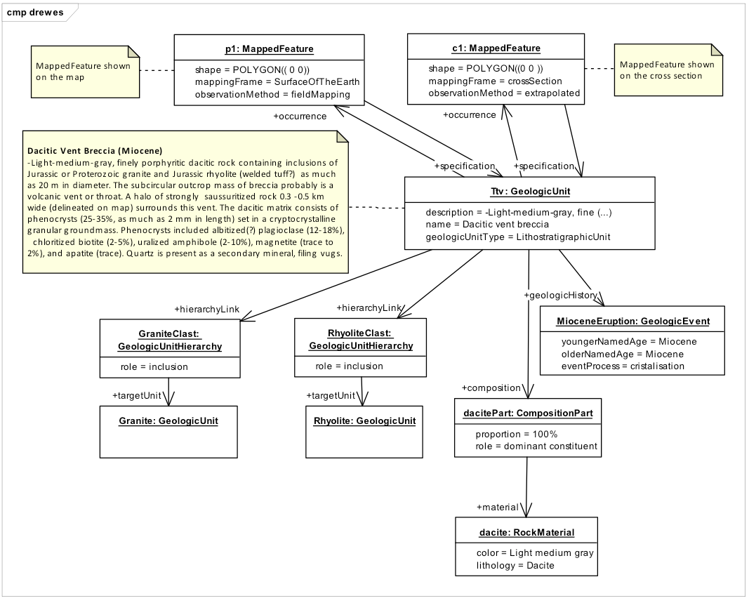
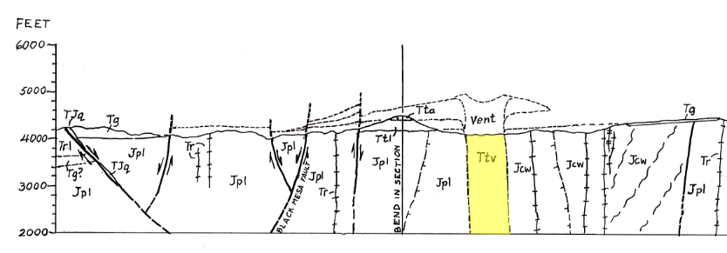
Name : GeoSciml
Contact
https://www.opengeospatial.org/standards/geosciml
Other pictures
BRGM THE FRENCH GEOLOGICAL SURVEY WWW.BRGM.EU

Slide 4
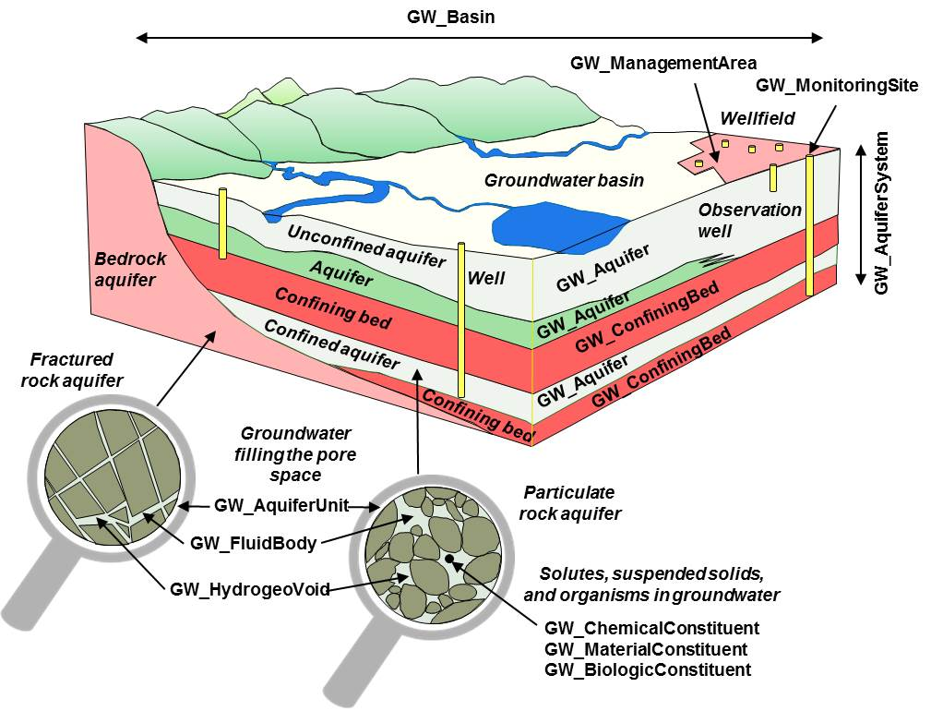
Name : GroundwATERML2
A conceptual and logical model for
groundwater resources management
Age : V 2.2
Key features
Core groundwater elements such as aquifers, their pores, and fluid bodies,
Wells and construction component, springs, and monitoring sites
Observations: constituents (bio, chemical, materials constituent), groundwater flow within/between containers,
AquiferTest / pump test
Weight
Full and draft ‘Lite’ versions
Children / Family
Reused by many geological surveys
Wishes
Currently moving to the semantic web
BRGM THE FRENCH GEOLOGICAL SURVEY WWW.BRGM.EU

Slide 5
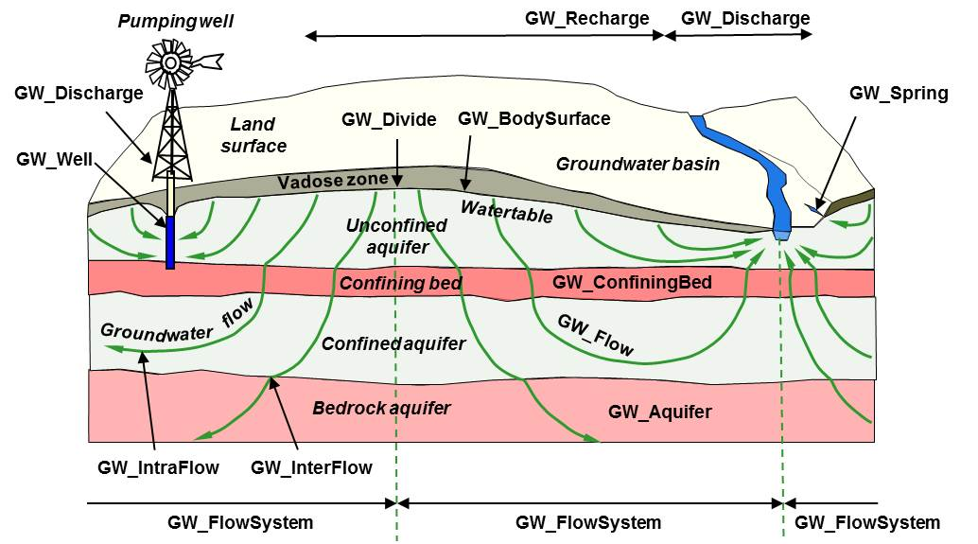
Name : GroundwATERML2
Contact
https://www.opengeospatial.org/standards/gwml2
Other pictures
BRGM THE FRENCH GEOLOGICAL SURVEY WWW.BRGM.EU

Slide 6
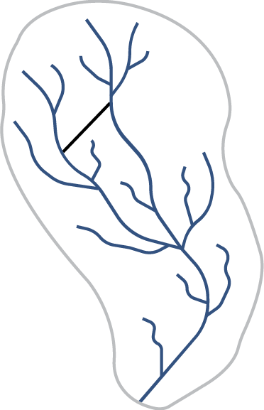
Name : surface Hydrology Features
(HY_Features)
A conceptual model describing hydrology features and their relationships independent of their geometric representation and scale.
Age : V 1.0
Key features
Hydrology specific feature types, e.g. catchments, drainage networks, rivers, lakes and waterbodies, hydrometric features
Focus is on surface water features and the networks they form.
Weight
Full version
Children / Family
USGS, NrCAN, BRGM, AU Hydrological Geo Fabric
Wishes
Currently moving to the semantic web
BRGM THE FRENCH GEOLOGICAL SURVEY WWW.BRGM.EU

Slide 7
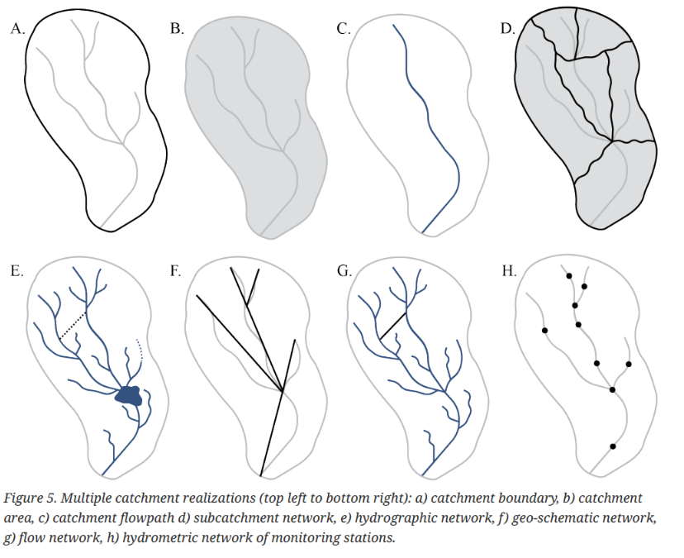
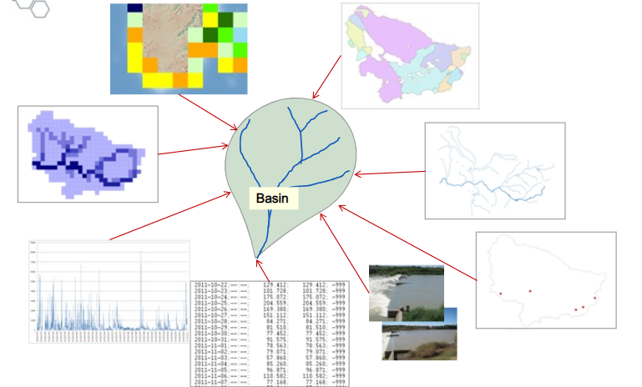
Name : surface Hydrology Features
(HY_Features)
Contact
http://docs.opengeospatial.org/is/14-111r6/14-111r6.html
http://opengeospatial.github.io/HY_Features/HY_Features_primer/HY_Features_Primer.html#/
Other pictures
Global Runoff Data Centre (GRDC)
BRGM THE FRENCH GEOLOGICAL SURVEY WWW.BRGM.EU

Slide 8
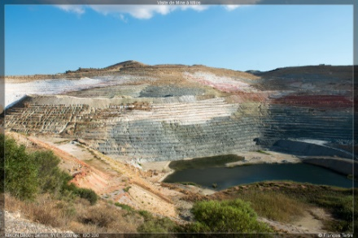
Name : EarthResourceML
Logical model for the exchange of digital information for
mineral occurrences, mines and mining activity.
Age : V 2.0
Key features
Geological features of mineral occurrences, their commodities, mineral resources and reserves
Mines and mining activities, and the production of concentrates, refined products, and waste materials.
Weight
Full and ‘Lite’ versions
Children / Family
Reused by many geological surveys and countries, continent wide spatial data/research projects (INSPIRE, Minerals4EU, EPOS, AuScope, …)
Wishes
Currently moving to the waste (urban mine, secondary raw materials)
BRGM THE FRENCH GEOLOGICAL SURVEY WWW.BRGM.EU

Slide 9
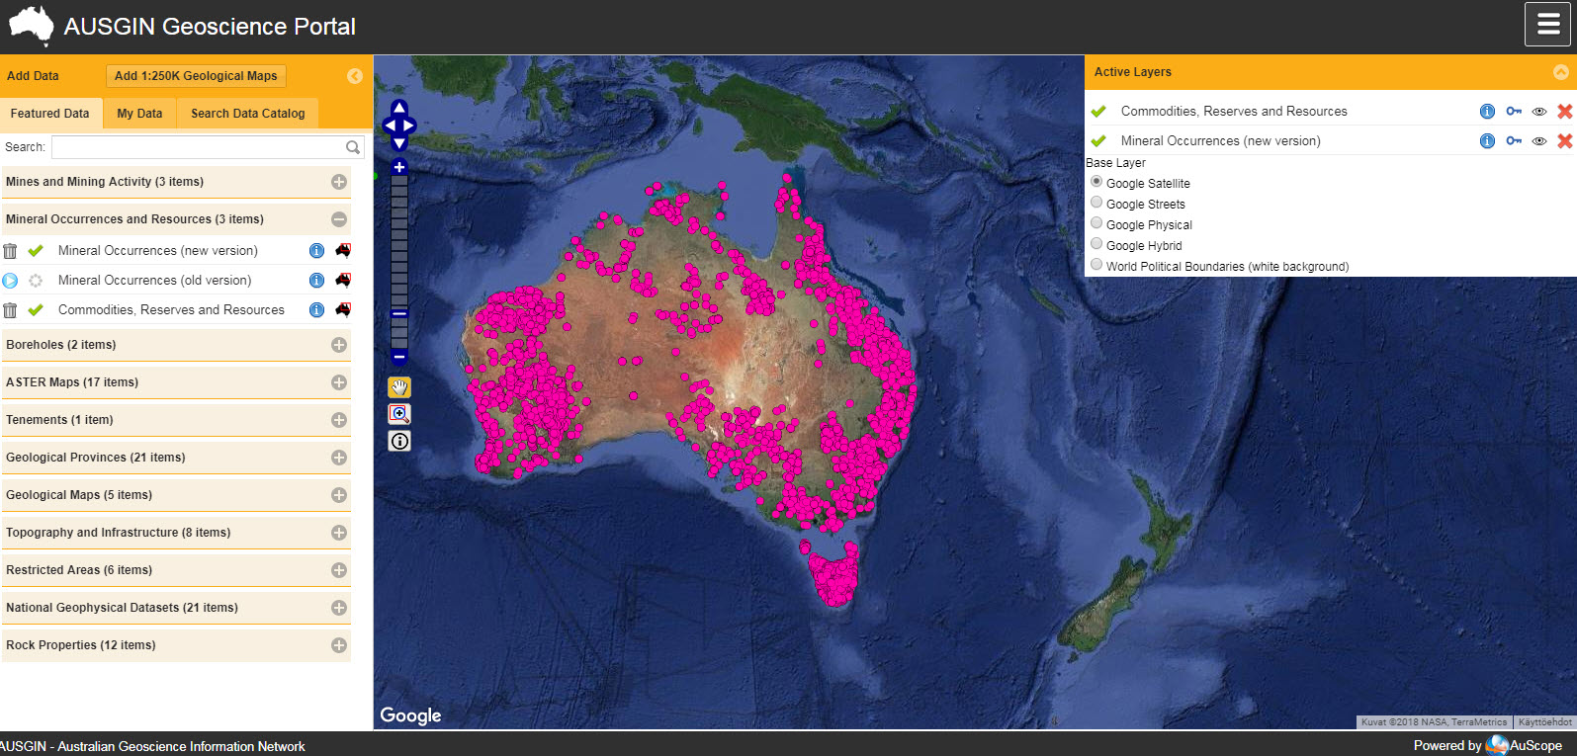
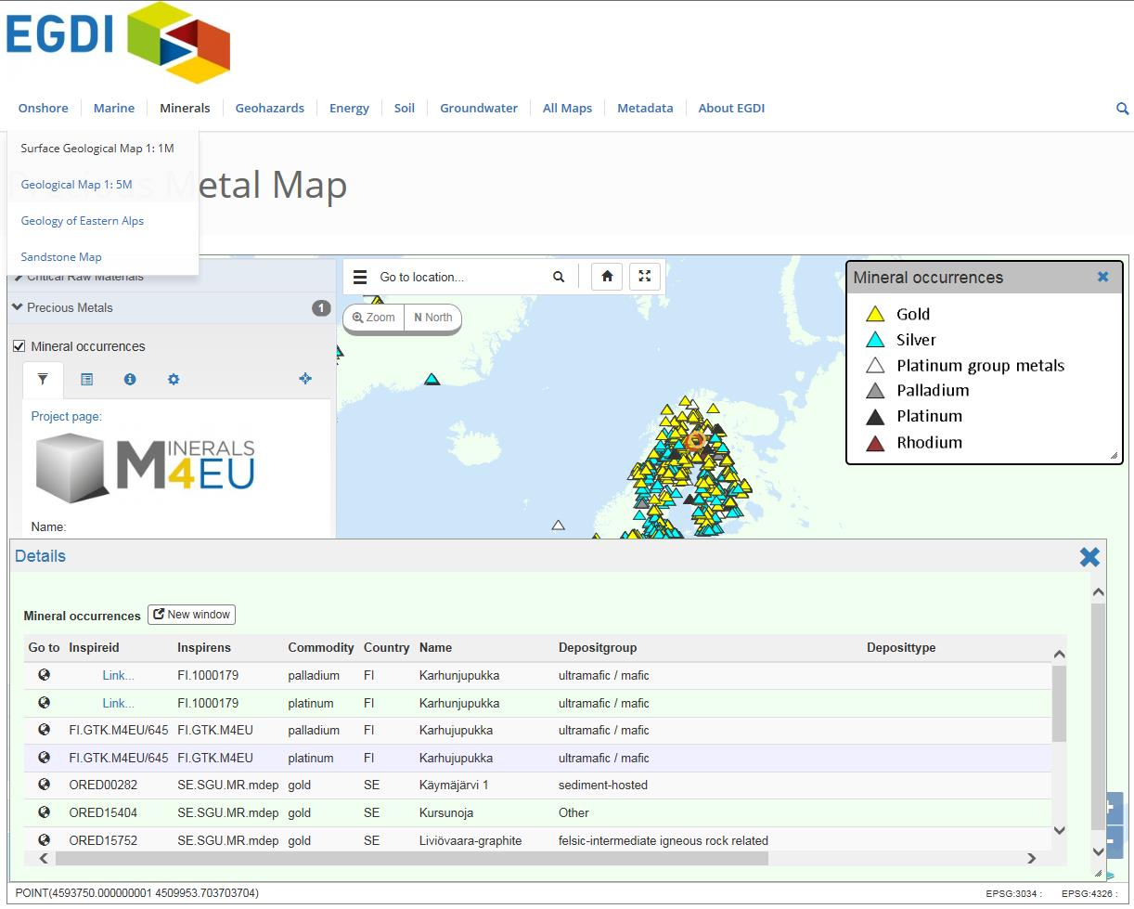
Name : EarthResourceML
Contact
http://www.earthresourceml.org/
Comments
Is not OGC but IUGS/CGI (where GeoSciML incubated), is connected to GeoSciML and driven by the ‘same’ experts.
Other pictures
BRGM THE FRENCH GEOLOGICAL SURVEY WWW.BRGM.EU
Notes:
IUGS Commission for the Management and Application of Geoscience Information

Slide 10
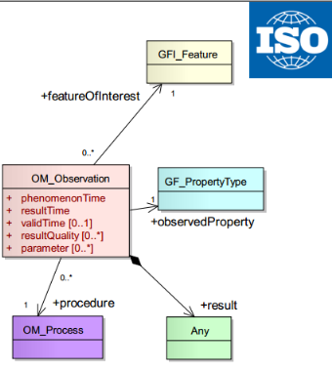
Name : Observations & Measurements
Conceptual and logical model for observations and features
involved in sampling when making observations for the exchange
of information within and between different scientific
and technical communities.
Age : V 2.0
Key features
Description of the observation acts and their results
A common set of sampling feature types classified primarily by topological dimension, as well as samples for ex-situ observations.
Relationships between sampling features (subsampling, derived samples)
Weight
Full and ‘Lite’ versions
Children / Family
Many international reuse by communities, profiles
BRGM THE FRENCH GEOLOGICAL SURVEY WWW.BRGM.EU

Slide 11
Name : Observations & Measurements
Wishes
Just arrived in the semantic web
Contact
https://www.opengeospatial.org/standards/om
Comments
Previous domain standards all refer to / build on Observations and Measurements
International ISO Standard (ISO 19156:2011)
Major uptake in
Domains (see next slide)
Also standardization bodies (ex : W3C SSN/SOSA)
BRGM THE FRENCH GEOLOGICAL SURVEY WWW.BRGM.EU

Slide 12
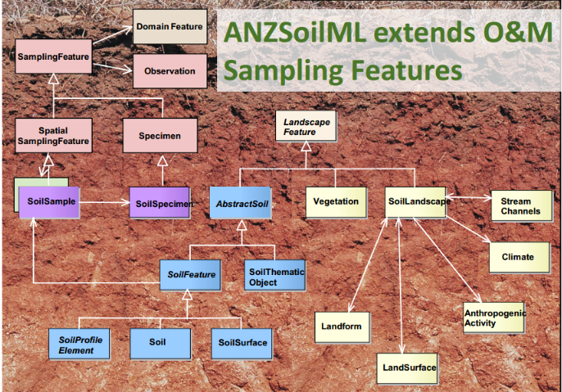
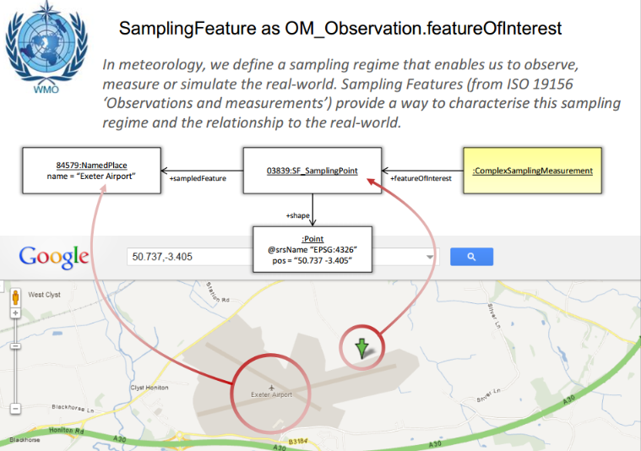
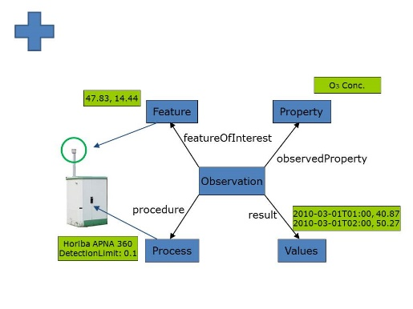
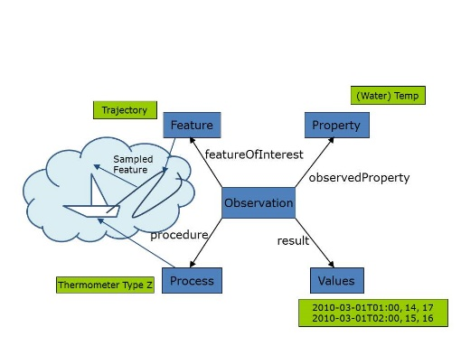
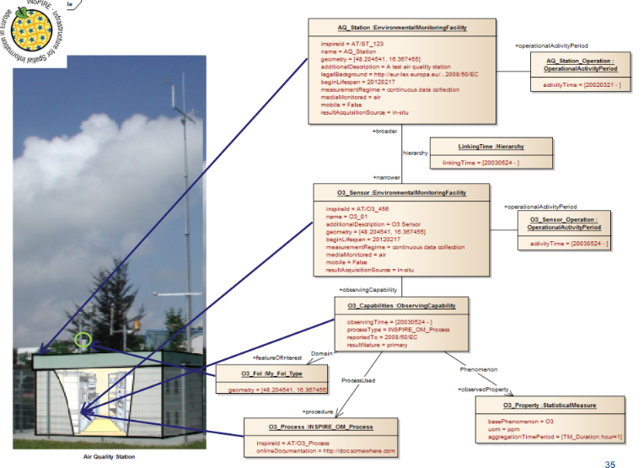
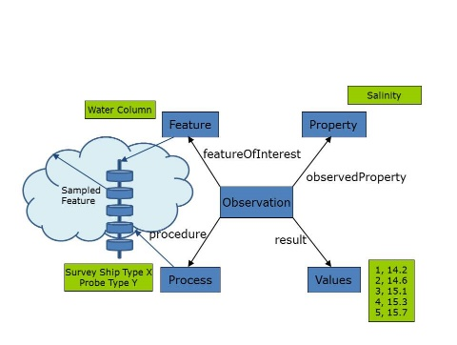
Name : Observations & Measurements
Other pictures
WMO ‘METeorological Community Exchange’ model
EU INSPIRE guidelines for O&M
EU Air Quality Directive
BRGM THE FRENCH GEOLOGICAL SURVEY WWW.BRGM.EU

Slide 13
Those Geoscience Domain standards are linked
Observations & Measurements
EarthResourceML
GeoSciML
GroundWaterML
HY_Features
?
?
?
?
City GML
LandInfra / InfraGML
Let’s reach out to
city and infra standards
bSI
Note: Other could have been mentioned, like OGC WaterML2 Part 1& TimeseriesML, Soil Interoperability Experiment (IE), Borehole IE

Slide 14
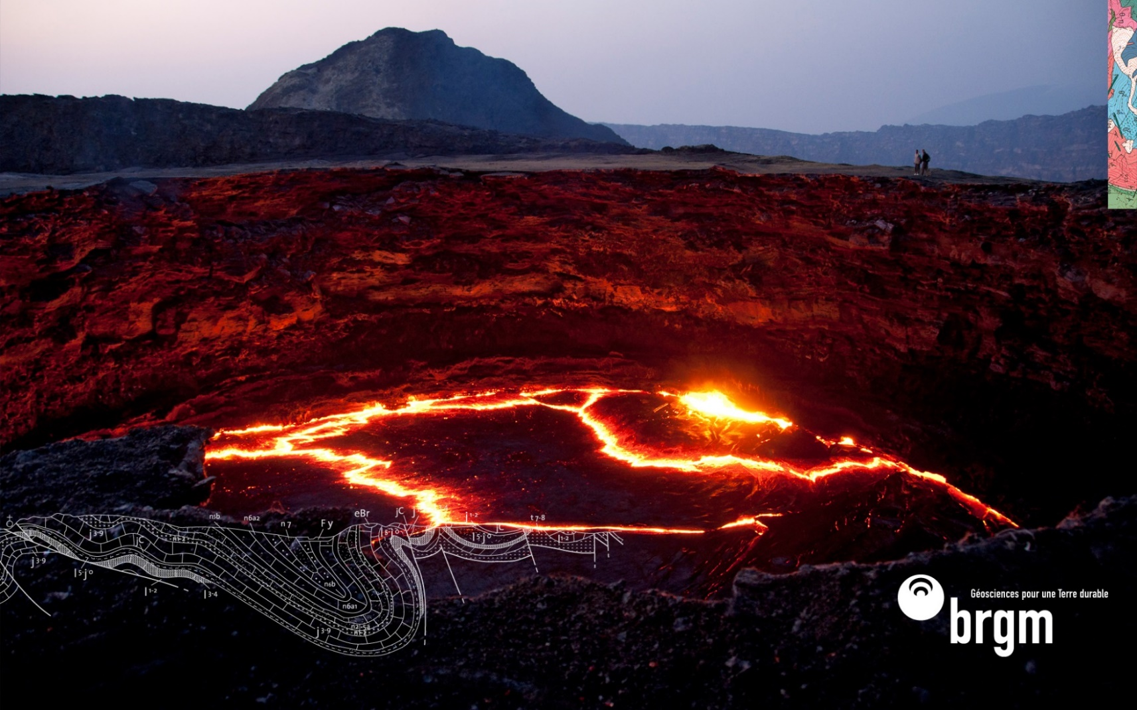
Thank you
S.Grellet@brgm.fr
Additionnal credits
GeoSciML, GWML2, HY_Features, ERML teams
S.JD.Cox - 2013 Leptoukh Lecture
BRGM THE FRENCH GEOLOGICAL SURVEY WWW.BRGM.EU

